Slide 1
Design of Carry Lookahead Adders
To reduce the computation time
  faster ways to add two binary numbers by using carry lookahead adders.
  creating two signals P (Carry Propagator) and G ( Carry Generator). The block diagram of a 4-bit Carry Lookahead Adder is shown in next slide

Slide 2
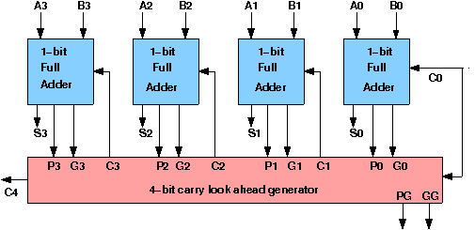
Pi s’ : -1 gate
delay after
A,B,Co input
Cis generated after 2 Gate Delays from Pi s’

Slide 3
Sum_{i} = A_{i} ⊕ B_{i} ⊕ C_{i}
C_{i+1} = A_{i} · B_{i} + (A_{i} ⊕ B_{i} ) C_{i}
Replace by
P_{i} = A_{i} ⊕ B_{i}
G_{i} = A_{i} · B_{i}
The output sum and carry can be expressed as
Sum_{i} = P_{i} ⊕ C_{i}
C_{i+1} = G_{i} + ( P_{i} · C_{i})
Boolean function for the carry output of each stage and substitute for each Ci its value from the previous equations:
C₁ = G₀ + P₀ · C₀
C₂ = G₁ + P₁ · C₁ = G₁ + P₁ · G₀ + P₁ · P₀ · C₀
C₃ = G₂ + P₂ · C₂ = G₂ + P₂ · G₁ + P₂ · P₁ · G₀ + P₂ · P₁ · P₀ · C₀
C₄ = G₃ + P₃ · C₃ = G₃ + P₃ · G₂ + P₃ · P₂ · G₁ + P₃ · P₂ · P₁ · G₀ + P₃ · P₂ · P₁ · P₀ · C₀
(Note:Five fan in gate is practical limit)

Slide 4
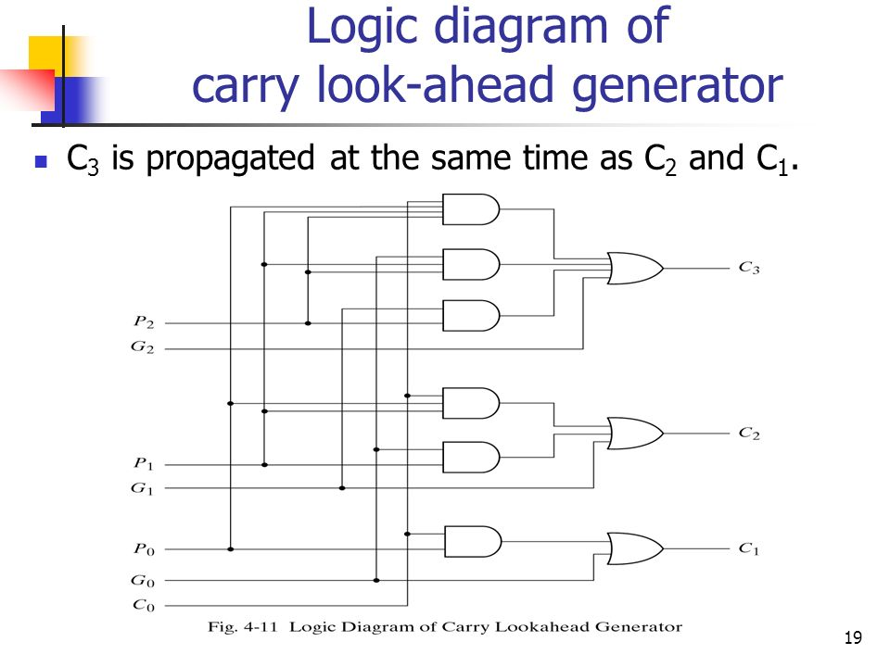
2 Gate Delays

Slide 5
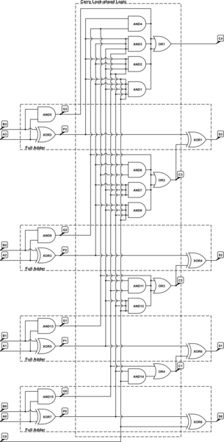
2 Gate Delays

Slide 6
Group Propagate and Group Generate Delay
The Carry Look Ahead 4-bit adder can also be used in a higher-level circuit by having each CLA Logic circuit produce a propagate and generate signal to a higher-level CLA Logic circuit. The group propagate (PI0) and group generate (GI0) for a 4-bit CLA are:
  PI0= P₃ · P₂ · P₁ · P₀ 1 gate level (and) after Pi
  GI0= G₃ + P₃ · G₂ + P₃ · P₂ · G₁ + P₃ · P₂ · P₁ · G₀
  (2gate levels (and,or) after Pi and Gi)

Slide 7
All 4bit adder Si - 4 gate delays, PG=PI0
All 4 bit adder Ci – 3 gate delays GG=GI0
2 Gate Delays
1 gate delays 2gate delays
After Pi and Gi

Slide 8
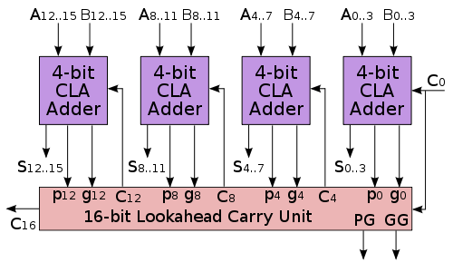
2gate Levels
C4 to C12 : 5 gate delays, C15 : 2 more gate delays in 4bit CLA(5+2=7)
S15 .. S 4 : 1 more gate delays= 1+7=8

Slide 9
Compare Carry Look Ahead to Ripple Carry
The signal from input carry C_{in} to output carry C_{out} requires an AND gate and an OR gate
  two gate levels.
four full adders in the parallel adder, the output carry C₅ would have 2 X 4 = 8 gate levels from C₁ to C₅. For an n-bit parallel adder, there are 2n gate levels to propagate through for ripple carry adder
16 bit ripple carry 2 x 16 = 32gate delay

